Slide 1
FYP Proposal Presentation
Exam Seating Management System (ESMS)
Developed by: Aqeel Khan & Syed Tabish Ali Supervised by: Dr. Kashif Rizwan Coordinator: Mr. Khawaja Tahir Mehmood Department of Computer Science – FUUAST, Islamabad

Slide 2
Introduction
The current exam seating process in universities is mostly manual.
Leads to errors: duplicate seat numbers, overlapping schedules, and confusion.
Our system automates this entire process.
Ensures accuracy, transparency, and time efficiency.

Slide 3
Problem Statement
Manual seat allocation causes:
Overlapping exam schedules
Duplicate seat assignments
Human errors and inefficiency
Difficulty managing hall capacities
Need for an automated web-based system to handle seating arrangements smartly.

Slide 4
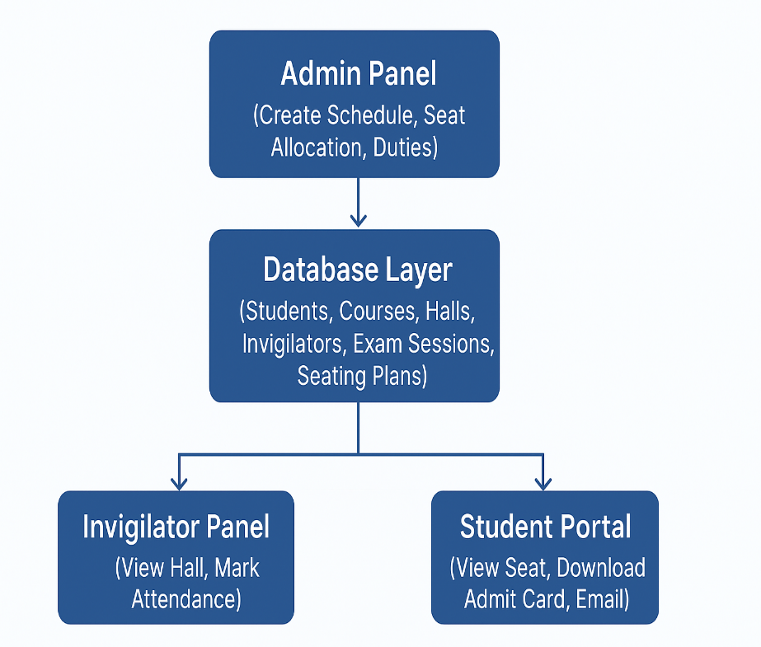
Proposed System
A web application that automates exam scheduling,
seat allocation, and hall management.
Key Features:
Auto seat allocation
Clash detection
Invigilator duty assignment
Admit-card generation
Email notifications for students
Supports Admin, Invigilator, and Student roles.

Slide 5
Objectives
Reduce manual workload and human error.
Automate clash detection and hall allocation.
Provide digital admit cards with QR/barcode.
Ensure fair and transparent seat distribution.
Generate real-time reports and attendance sheets.

Slide 6
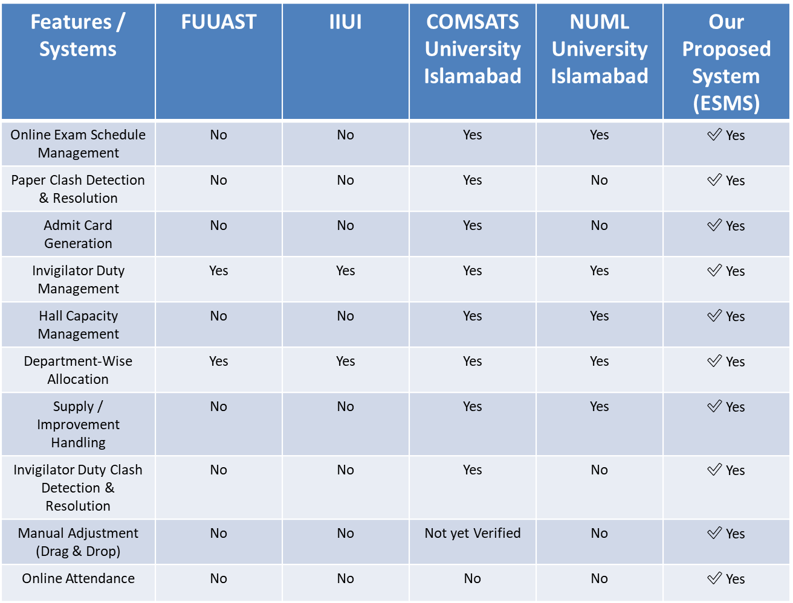
Table 1.1: Survey Analysis

Slide 7
Modules and Sub-Modules
User & Role Management • Admin – Creates exam schedules, seating plans, and manages invigilators • Invigilator – Views assigned halls and marks attendance • Student – Views seat number and exam slip
Program & Course Management • Program Details – e.g., BS Computer Science • Course Details – Course code, title, semester, teacher • Teacher Mapping – Links each course to a department teacher
Student Information Management • Student Profile – Roll number, name, semester, section • Registered Courses – Courses enrolled by the student • Special Flags – e.g., Improvement, Supply

Slide 8
Date Sheet Management • Create/Edit • Clash Detection • Department Scheduling • Dynamic Updates • Export/Notify • Seating Integration
Subject Exam Overlap Management • Check for Exam Clashes • Rules for Rescheduling (Same-Time Exams) • Create/Edit Exam Schedule • Morning/Evening Sessions • Generate Clash Report
Exam Hall & Seating Management • Define Halls (Name, Capacity, Layout) • Mark Reserved/Blocked Seats • Seat Numbering Structure
Seating Plan Generation • Auto-Allocation by Subjects/Sections • Prevent Same-Subject Adjacency • Manual Adjustment Option • Generate Seating Reports

Slide 9
Invigilator Duty Management • Assign Invigilators per hall/session • Avoid Double-Duty Conflicts • Duty Roster and Attendance Report
Exam Slip / Admit Card • Auto-generate Slips with roll number, hall, seat number, subject, and timing • QR/Barcode Integration for quick verification • PDF Sheets for Attendance • Email Notifications to Students

Slide 10
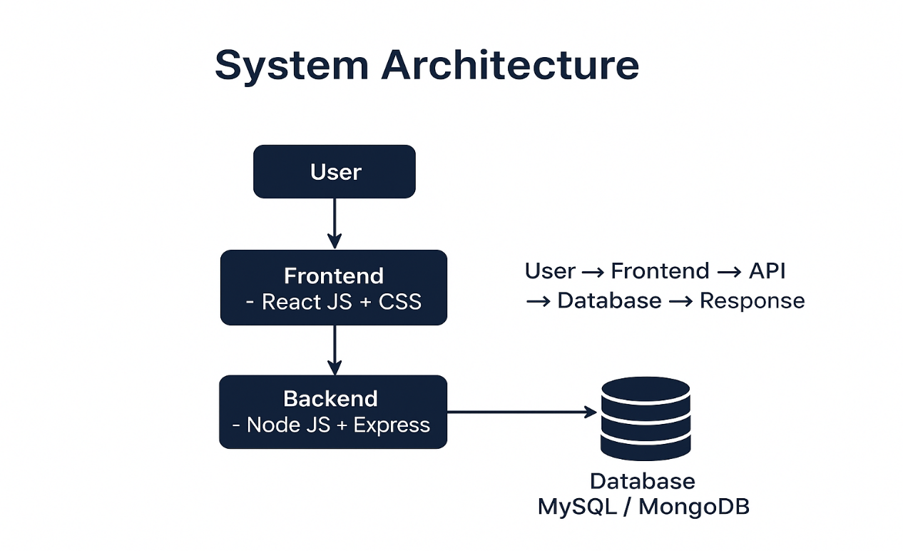
System Architecture
3-Tier Architecture
Frontend: React JS + CSS
Backend: Node JS + Express
Database: MySQL / MongoDB

Slide 11

Primary Actors
Admin / Exam Controller – Creates schedules, seating plans.
Invigilator – Marks attendance and checks assigned halls.
Student – Views seat number and downloads exam slip.

Slide 12
Tools and Technologies
Category | Tools
Frontend | React JS, CSS, Bootstrap
Backend | Node JS, Express
Database | MySQL / MongoDB
IDE | VS Code
Version Control | GitHub
Deployment | Shared Hosting / Localhost

Slide 13
Process Model and Design Approach
Model Used: RUP (Rational Unified Process)

Slide 14
Any Question Thank You

